Slide 1

GROUP MEMBERS :-
1. MEGHANA VINNAKOTA
2. PIYUSH CHAUDARI
3. LAISHRAM SINGH
4. DEVYANI PATIL
5. PRADEEP HEGDE
6. AJINKYA GALANDE

Slide 2
OBJECTIVE
Customer personality analysis helps a business to modify its product based on its target customers from different types of customer segments.
Finding the potential customers by analysing the behaviour of them is useful to understand the targeted customers.

Slide 3
PROJECT FLOW
Understanding business problem
Collection of data
Cleaning of data
Exploratory data analysis
Model building
Model deployment

Slide 4
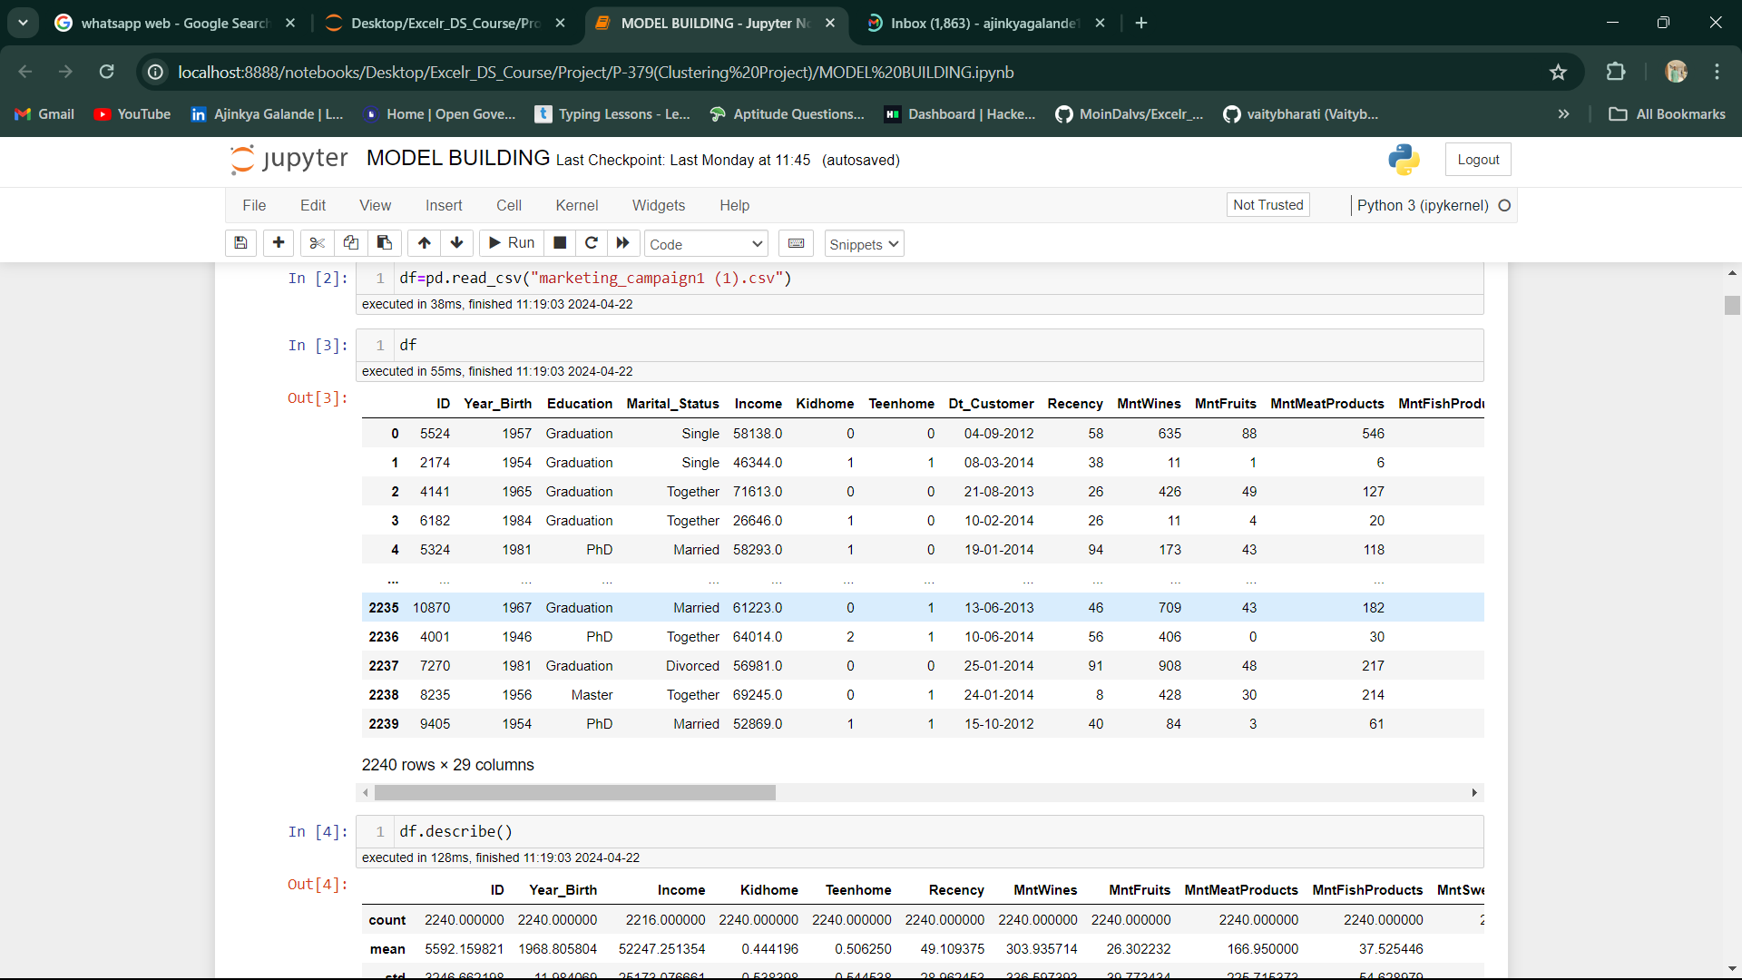
IMPORTING THE DATA

Slide 5
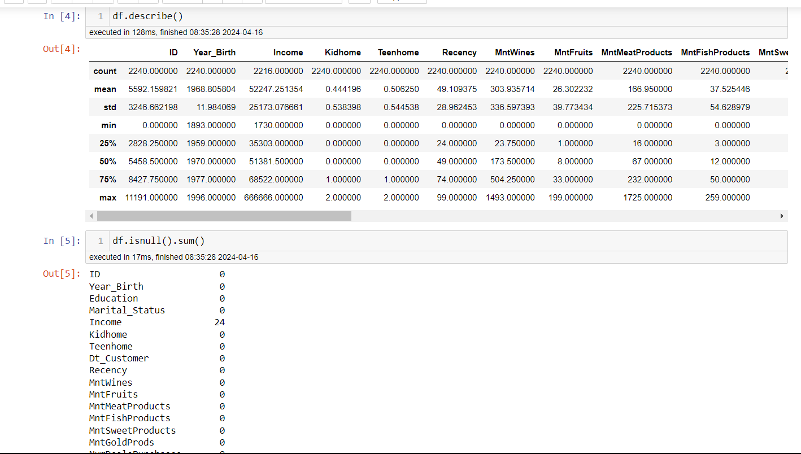
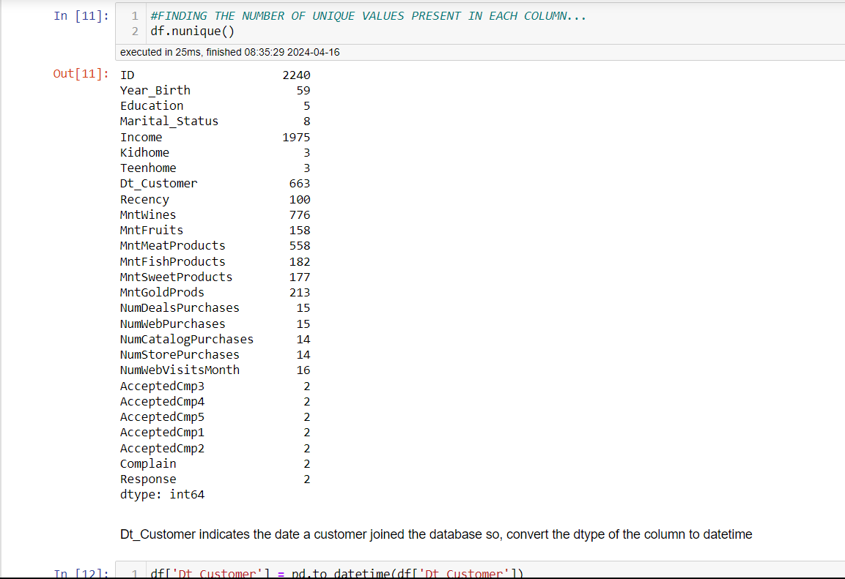
EXPLORATORY DATA ANALYSIS
Conducted EDA using descriptive statistics like Mean, Median and Mode for the numerical values

Slide 6
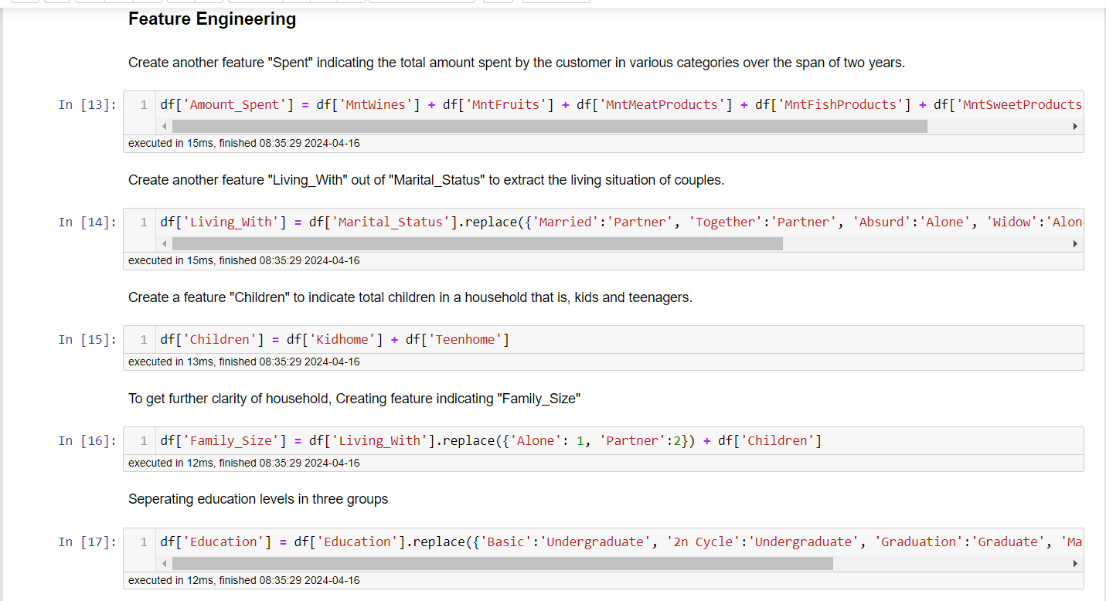
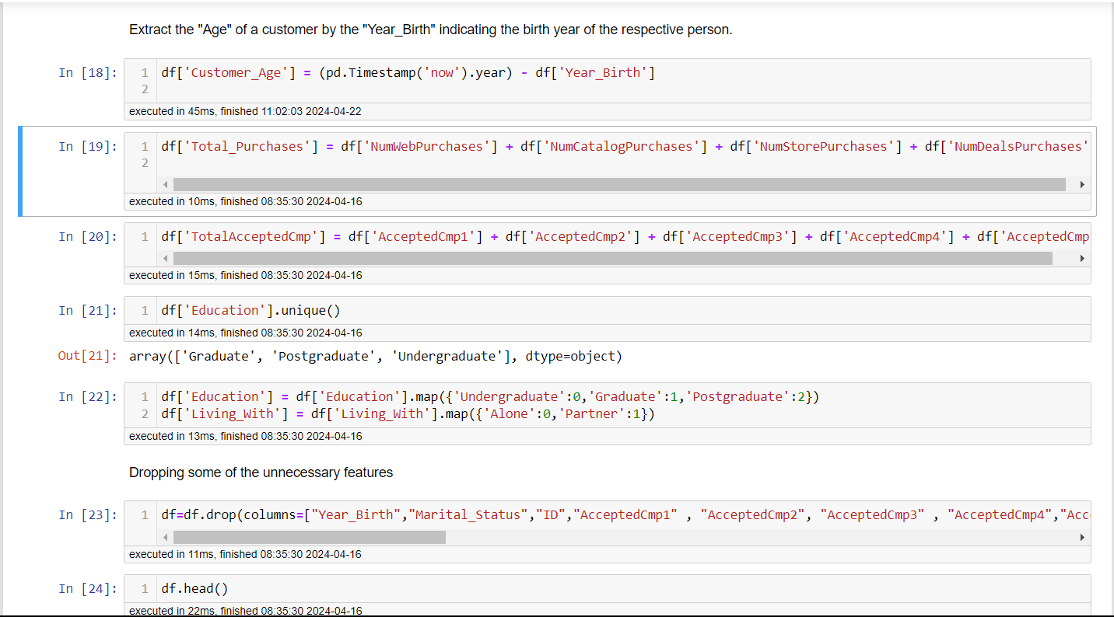
Done some feature engineering to reduce the size of the dataset by adding some columns to form a new one along with label encoding to build a model

Slide 7
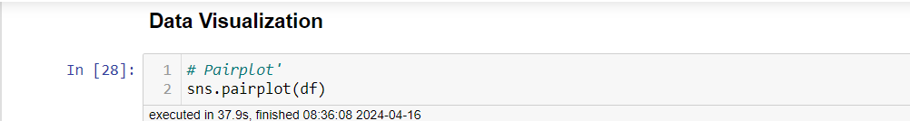
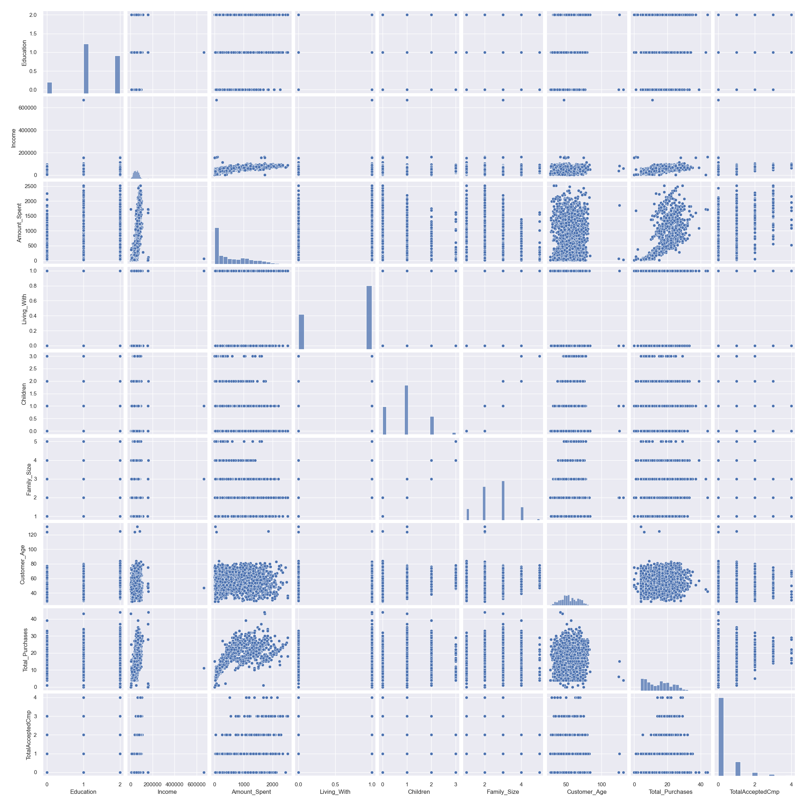

Slide 8
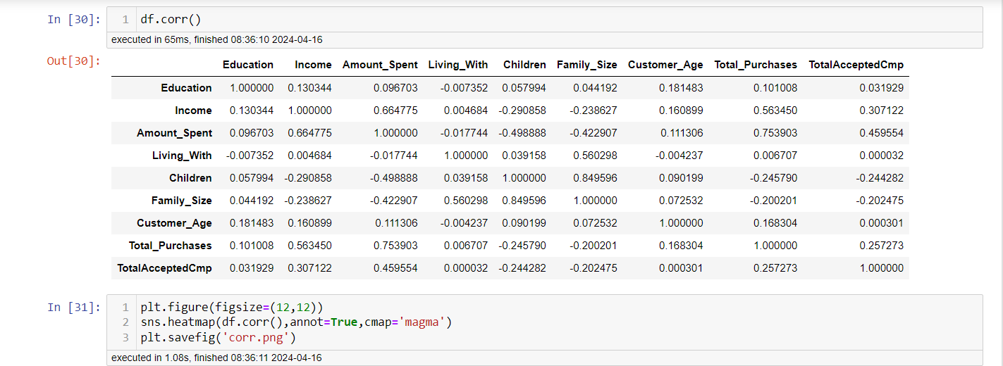
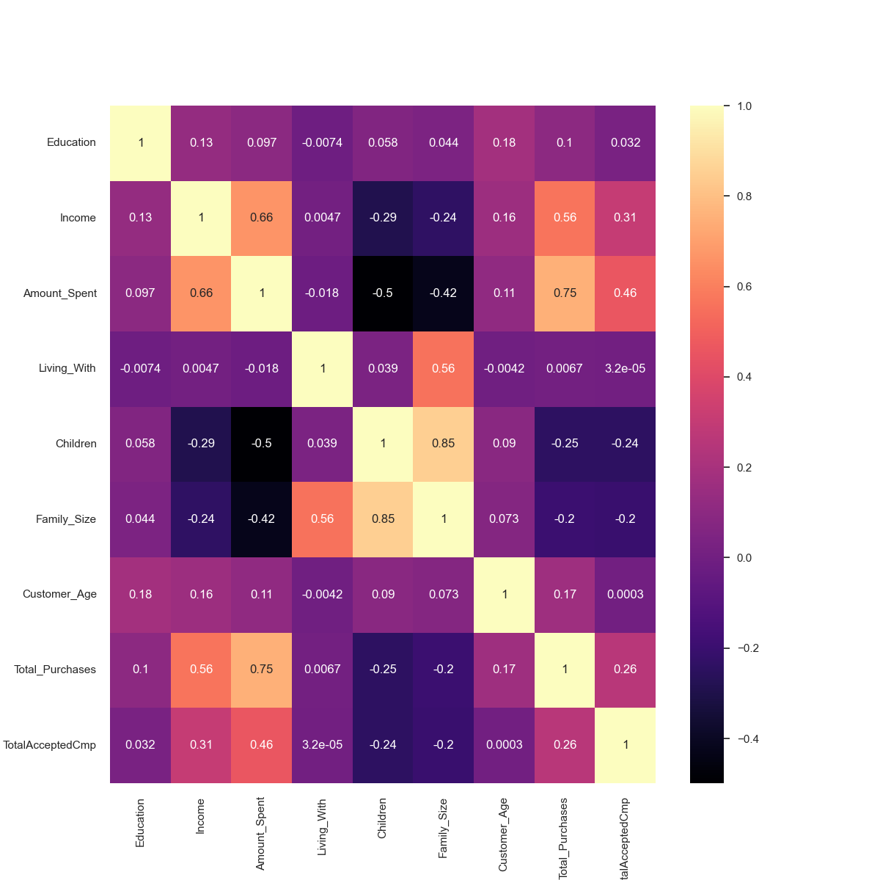
This signifies that the relationship between different variable ranging between 0 to 1 where 0 representing weak relationship and 1 representing strong relationship

Slide 9
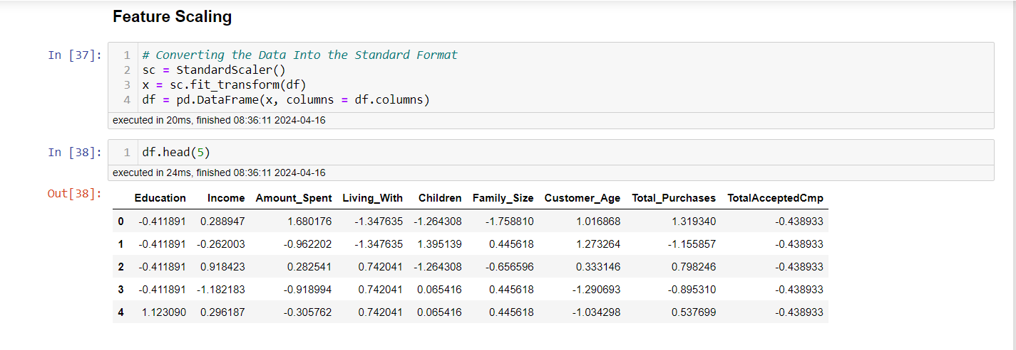
Standardizing the data set values to have good accuracy and smooth model building

Slide 10
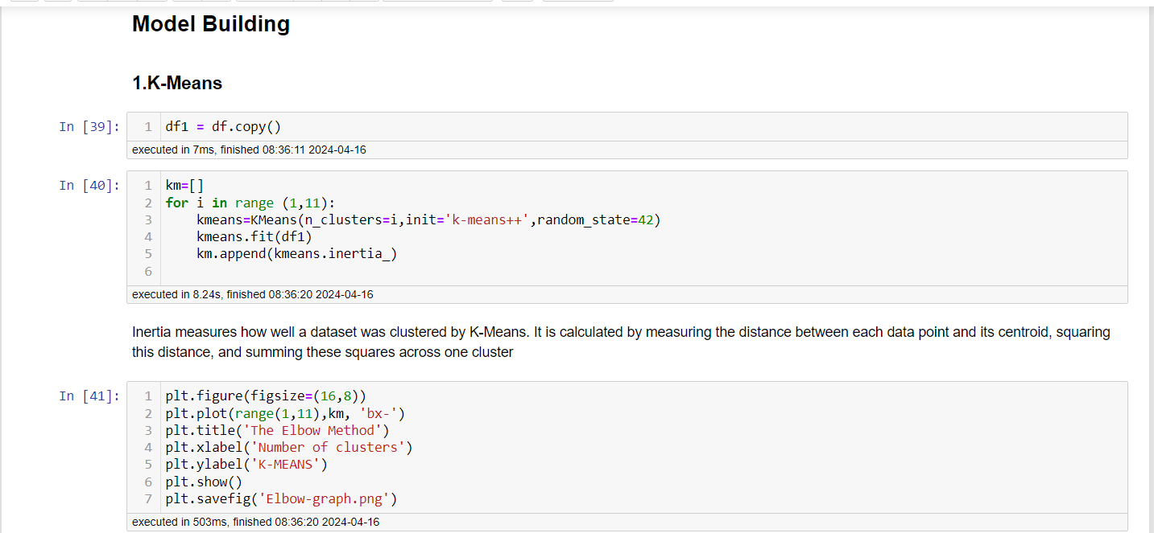
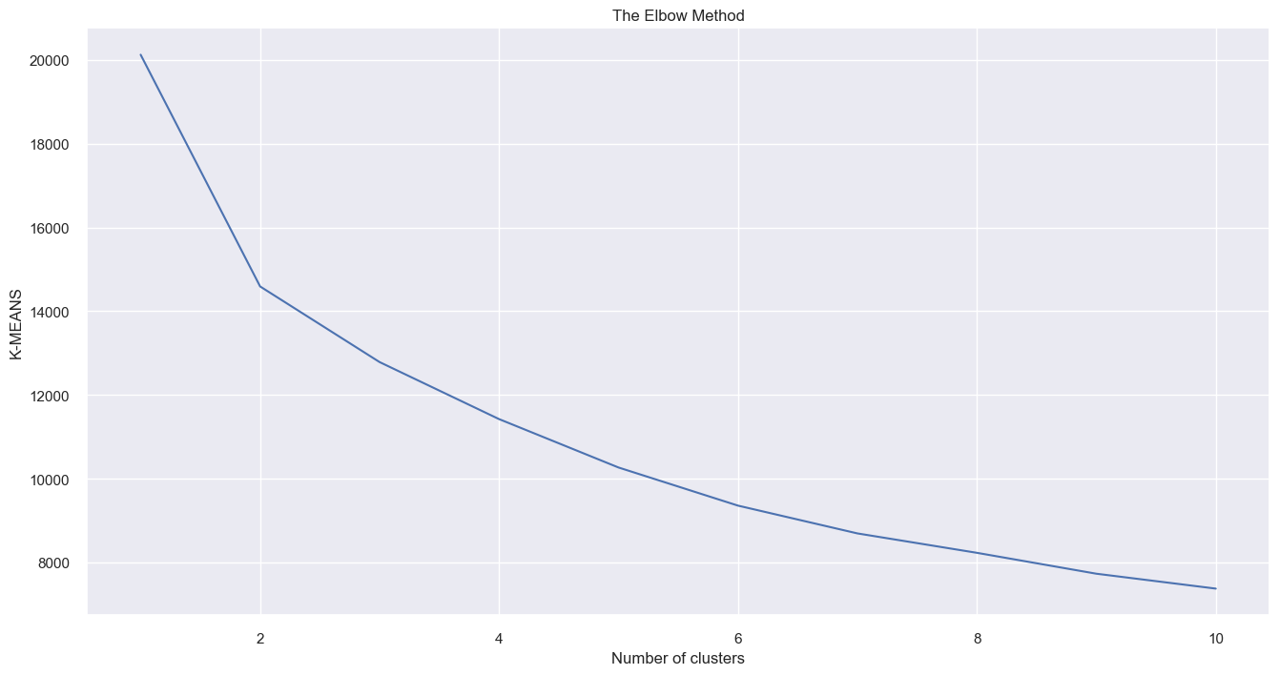
Built K Means Clustering and Hierarchical Clustering

Slide 11
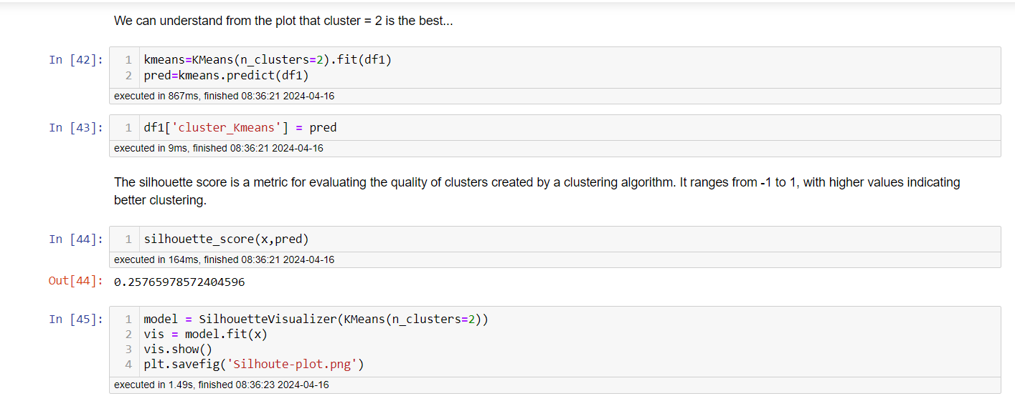

Slide 12
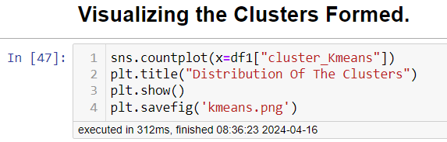
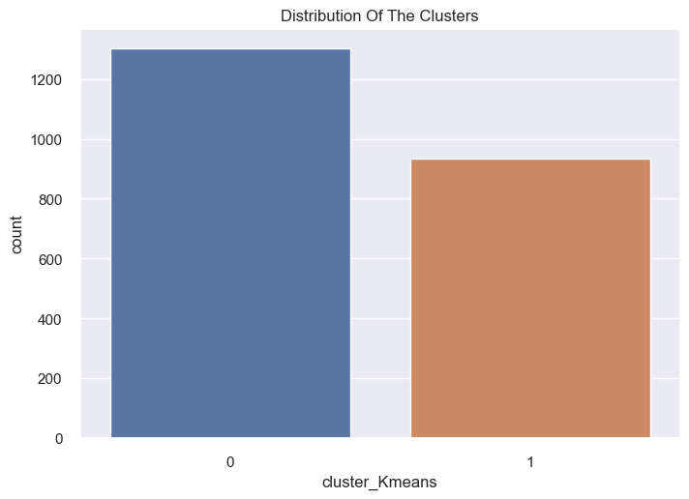

Slide 13
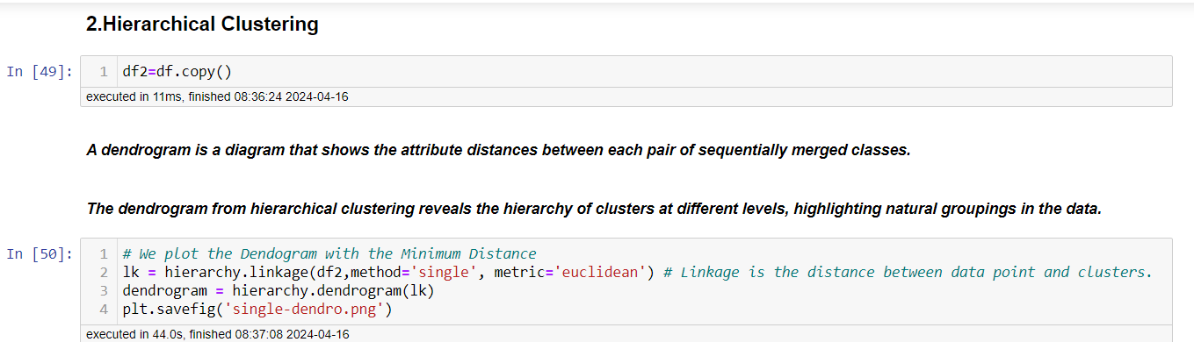
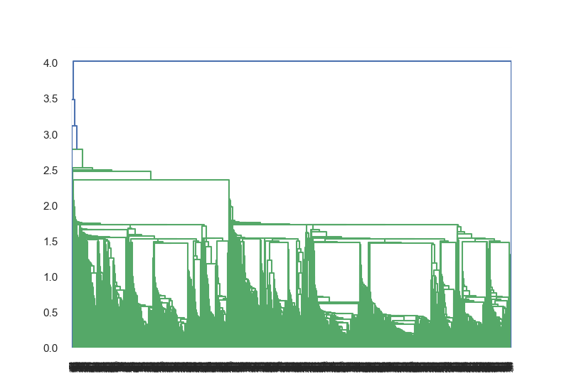

Slide 14
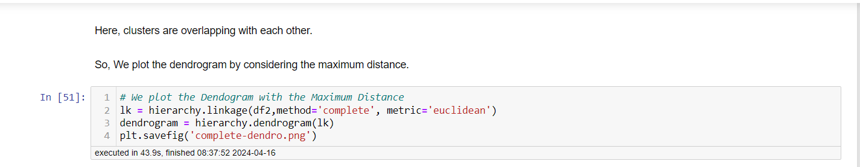
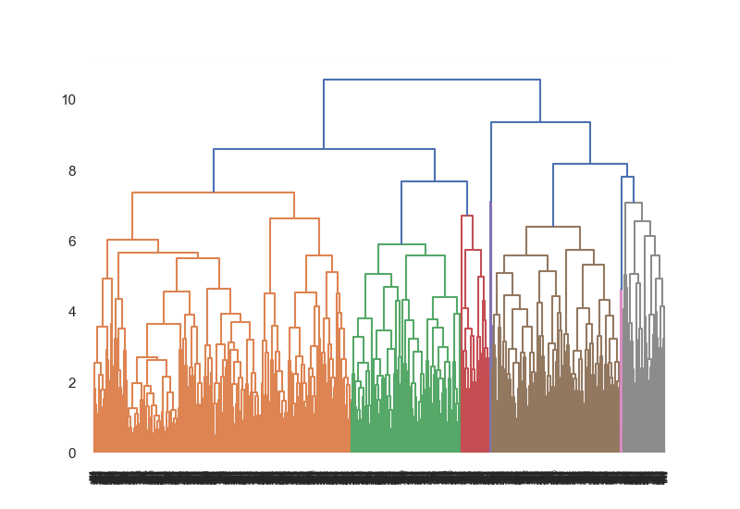

Slide 15
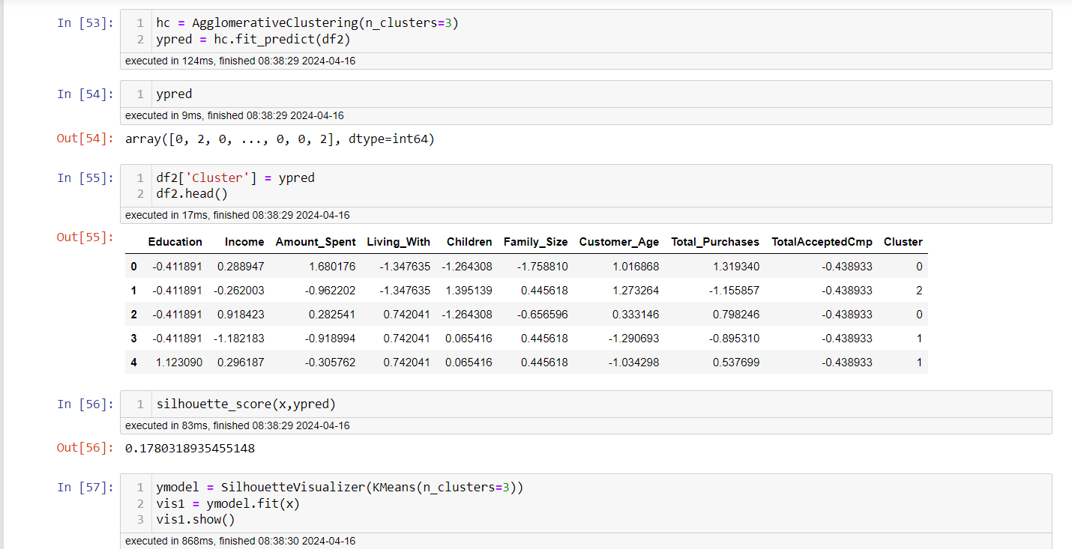

Slide 16
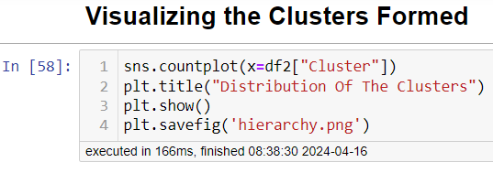
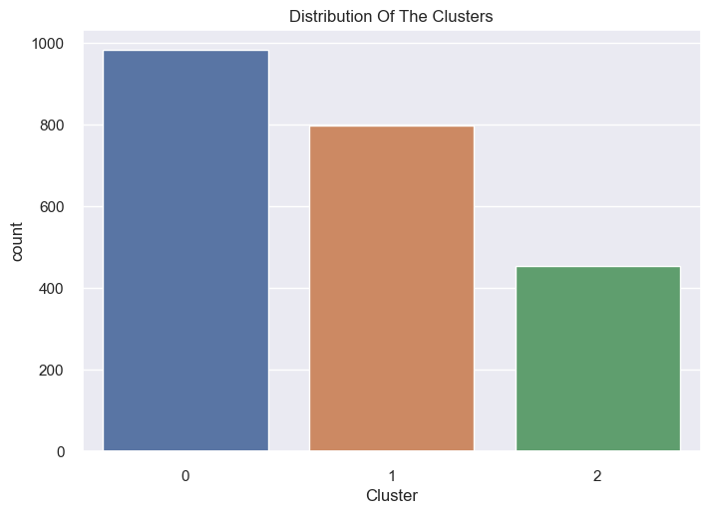

Slide 17
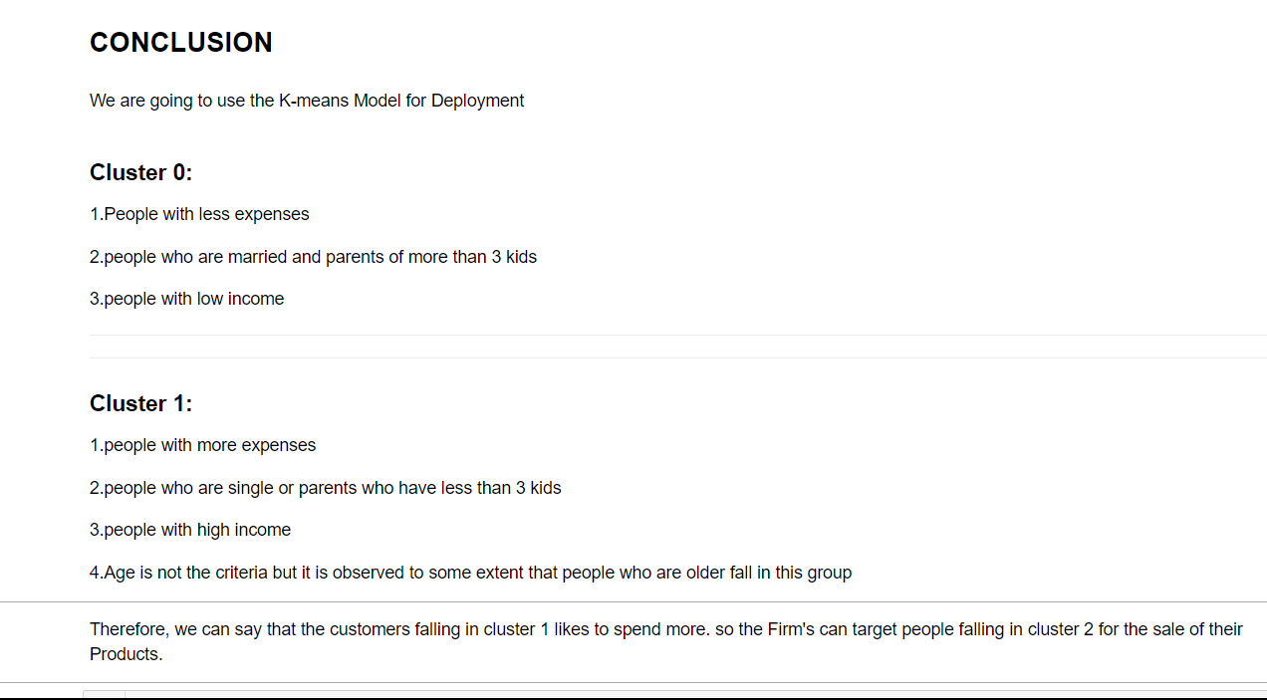

Slide 18
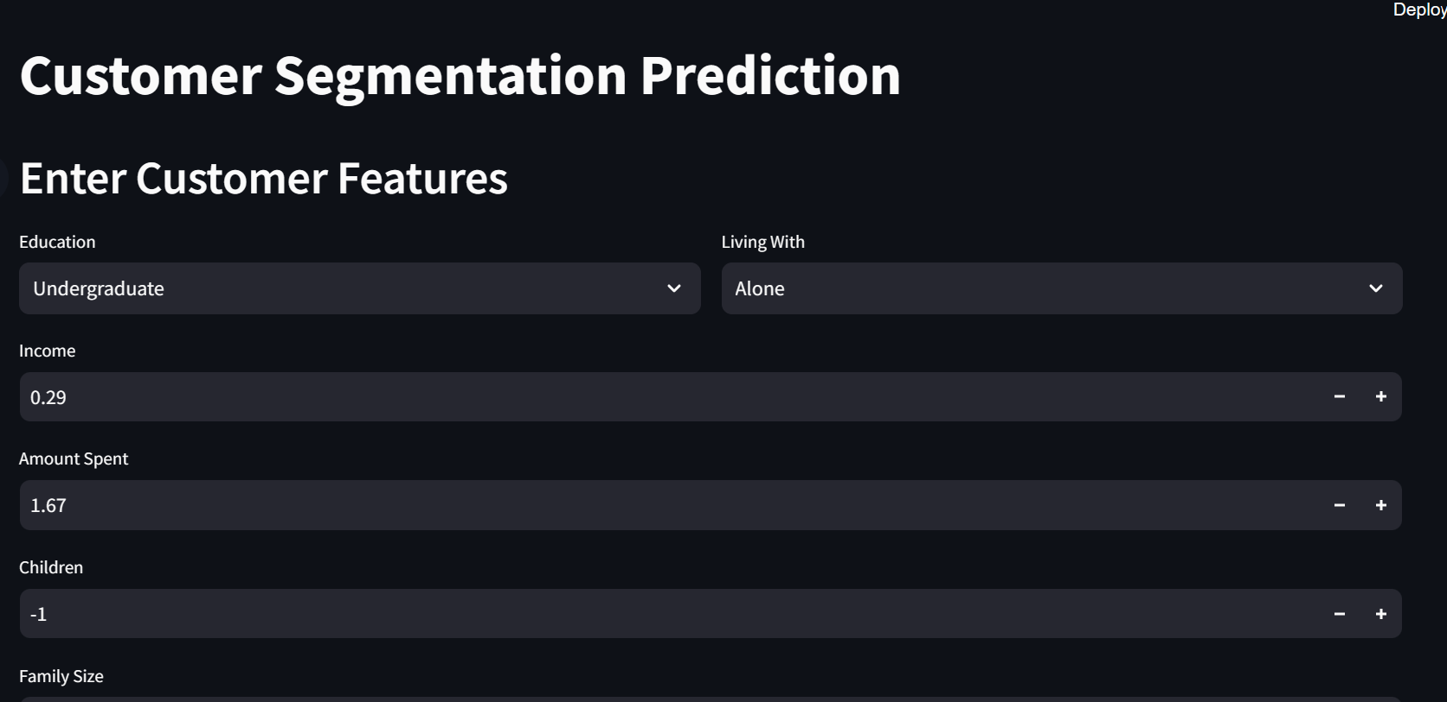
MODEL DEPLOYMENT
Built a deployment model based on the clustering model

Slide 19
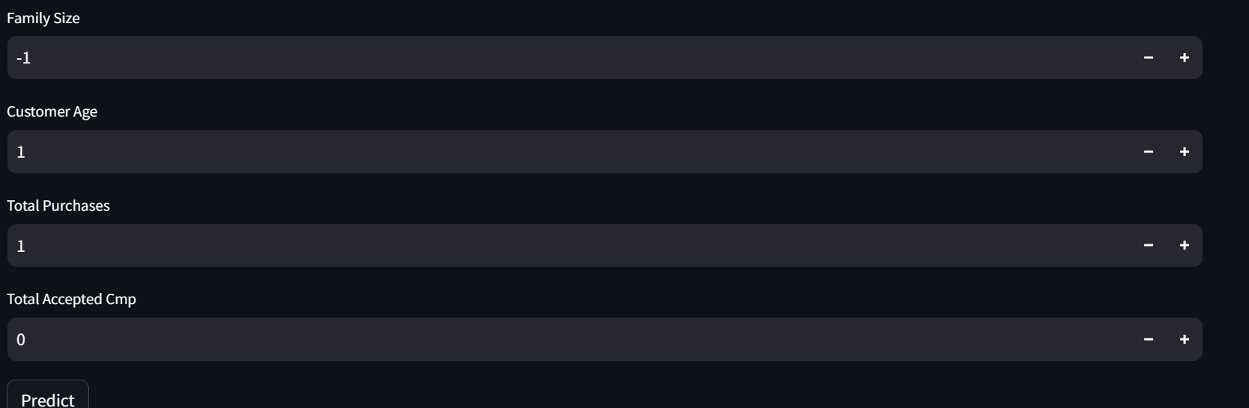

Slide 20
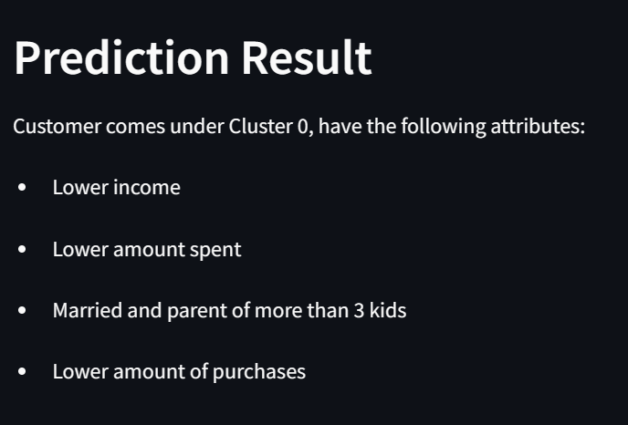

Slide 21
THANK YOU

